Slide 1
Chapter 2
Memory Basics

Slide 2
Memory definitions
Memory is a major component of a digital computer and is present in a large proportion of all digital systems.
Memory is a collection of binary storage cells together with associated circuits needed to transfer information into and out of the cells.
Random-access memory (RAM) stores data temporarily, and read-only memory (ROM) stores data permanently.

Slide 3
Memory Organization
Organized as an indexed array of memory cells.
Value of the index for each word is the memory address.
A Logic circuits, e.g., Decoder, Chip select,…,etc, are required
Often organized to fit the needs of a particular computer architecture ( capacity, and Performance).

Slide 4
Memory Performance
Access Time (Response time):
How quickly the memory can respond to a request (R/W).
The max time for applying the address to the appearance of data (READ), or the completion of storing (WRITE).
Memory cycle time:
The minimum period between two successive requests

Slide 5
Random-access memory (RAM)
Binary information is stored in memory in groups of bits, each group of which is called a word.
A word is an entity of bits that moves in and out of memory as a unit.
A group of eight bits is called a byte.
Most computer memories use words that are multiples of eight bits in length.
Communication between a memory and its environment is achieved through data input and output lines, address selection lines, and control lines that specify the direction of transfer of information.

Slide 6
Basic Memory Operations
Memory operations require the following:
Data : data written to, or read from, memory as required by the operation.
Address : specifies the memory location to operate on.
An operation : Information sent to the memory and interpreted as control information which specifies the type of operation to be performed. Typical operations are READ and WRITE

Slide 7
Memory Block Diagram
A basic memory system is shown here:
k address lines are decoded to address 2^{k} words of memory.
Each word is n bits.
Read and Write are single control lines defining the simplest of memory operations.
2 M x 16 RAM: K= 21
n= 16
n Data Input Lines
n
k Address Lines
Memory
k
Unit
2^{k} Words
1
n Bits per Word
Read
1
Write
n
n Data Output Lines

Slide 8
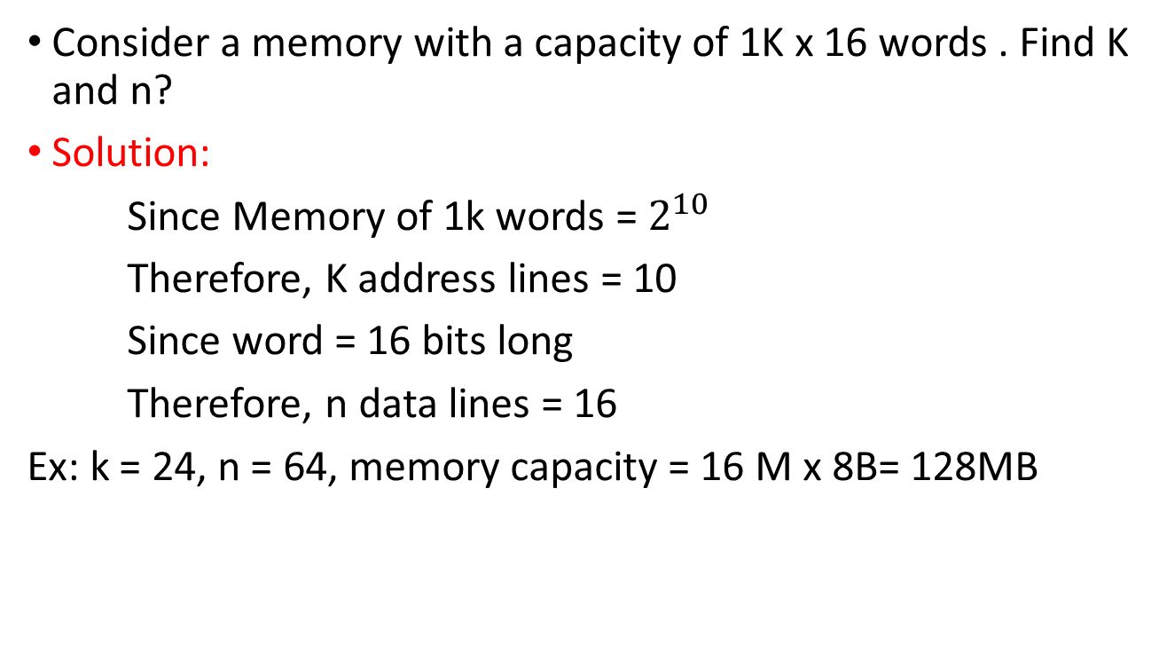
Example
Consider a memory with a capacity of 1K x 16 words . Find K and n?
Solution:
Since Memory of 1k words = $2^{10}$
Therefore, K address lines = 10
Since word = 16 bits long
Therefore, n data lines = 16
Ex: k = 24, n = 64, memory capacity = 16 M x 8B= 128MB

Slide 9
Basic Memory Operations (continued)
Read Memory
The steps that must be taken for a read are as follows:
1. Apply the binary address of the desired word to the address lines.
2. Activate the Read input.
Write Memory
The steps that must be taken for a write are as follows:
1. Apply the binary address of the desired word to the address lines.
2. Apply the data bits that must be stored in memory to the data input lines.
3. Activate the Write input.

Slide 11
Example
Assume that a CPU operates with a clock frequency of 50 MHz, giving a period of 20 ns for one clock pulse.
Suppose now that the CPU communicates with a memory with an access time of 65 ns and a write cycle time of 75 ns.

Slide 12
Timing Waveforms
Most basic memories are asynchronous
Storage in latches or storage of electrical charge
No clock
Controlled by control inputs and address
Timing of signal changes and data observation is critical to the operation
Read timing:
20 ns
Clock
T1
T2
T3
T4
T1
Address
Address valid
Memory
enable
Read/
Write
Data
Data valid
output
65 ns
Read cycle

Slide 13
Memory Operation Timing
Write timing:
20 ns
Clock
T1
T2
T3
T4
T1
Address
Address valid
Memory
enable
Read/
Write
Data
Data valid
input
75 ns
Write cycle

Slide 14
RAM Integrated Circuits
Types of random access memory
Static – information stored in latches
Dynamic – information stored as electrical charges on capacitors
Charge “leaks” off
Periodic refresh of charge required
Dependence on Power Supply
Volatile – loses stored information when power turned off
Non-volatile – retains information when power turned off

Slide 15
Static RAM (SRAM)

Slide 16
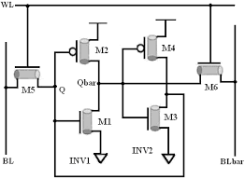
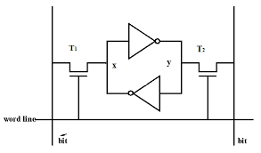
Basic SRAM Electronic Cell

Slide 17
SRAM Model
As indicated earlier, memory consists of RAM chips plus additional logic. The following figure shows the logic model of the RAM cell. The storage part of the cell is modeled by an SR latch. The inputs to the latch are enabled by a Select signal.

Slide 18
Cont.,
For Select equal to 0, the stored content is held.
For Select equal to 1, the stored content is determined by the values on B and B complement.
The outputs from the latch are gated by Select to produce cell outputs C and its Complement.
For Select equal to 0, both C and C complement are 0, and for Select equal to 1, C is the stored value and C complement is its complement.

Slide 19
SRAM Bit Slice Model
To obtain simplified static RAM diagrams, we interconnect a set of RAM cells and read and write circuits to form a RAM bit slice that contains all of the circuitry associated with a single bit position of a set of RAM words.
The loading of a cell latch is now controlled by a Word Select input.
If this is 0, then both S and R are 0, and the cell latch contents remain unchanged.
If the Word Select input is 1, then the value to be loaded into the latch is controlled by two signals B and B complement from the Write Logic.

Slide 21
2^{k} Word × 1-Bit RAM IC
To build a RAM IC from a RAM slice, we need:
Decoder :decodes the k address lines to 2^{k} word select lines
A Tri-state buffer :
on the data output permits RAM ICs to be combined into a RAM with 2^{k} x n words
4-to-16
0
Word select
Decoder
A
3
A
3
2
3
1
2
RAM cell
A
2
A
2
2
2
3
4
A
1
A
1
2
1
5
6
RAM cel
l
A
0
A
0
2
0
7
16 x
1
8
RAM
9
10
Data
Data
11
input
output
12
13
14
Read/
15
Write
Memory
RAM cell
enable
(a) Symbol
Read/Write
logic
Data input
Data in
Data
Data out
output
Read/
Bit
Write
select
Read/Write
Chip select
(b) Block diagram

Slide 22
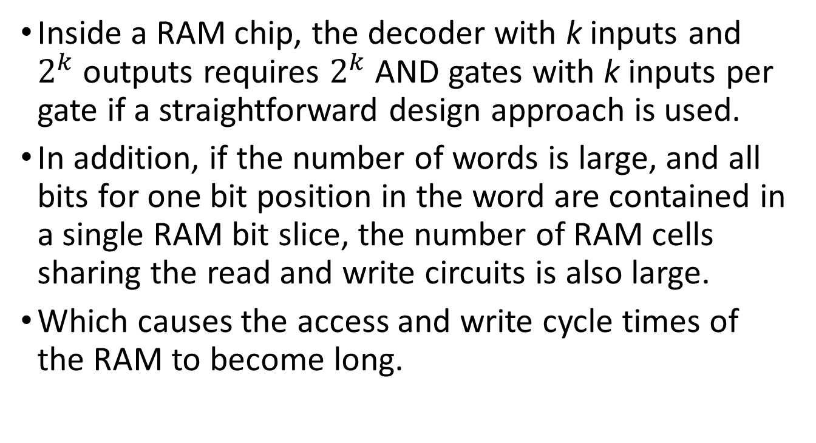
SRAM Design 1-Straightforward Design
Inside a RAM chip, the decoder with k inputs and $2^{k}$ outputs requires $2^{k}$AND gates with k inputs per gate if a straightforward design approach is used.
In addition, if the number of words is large, and all bits for one bit position in the word are contained in a single RAM bit slice, the number of RAM cells sharing the read and write circuits is also large.
Which causes the access and write cycle times of the RAM to become long.

Slide 23
2- Coincident Selection Design
Since the Memory arrays can be very large => The decoder size and fan outs can be reduced by using a coincident selection in a 2-dimensional array.
Uses two decoders, one for words and one for bits.
Word select becomes Row select (vertical decoder)
Bit select becomes Column select (Horizontal decoder)
I.e., two k/2-input decoders are used instead of one k-input decoder.

Slide 24
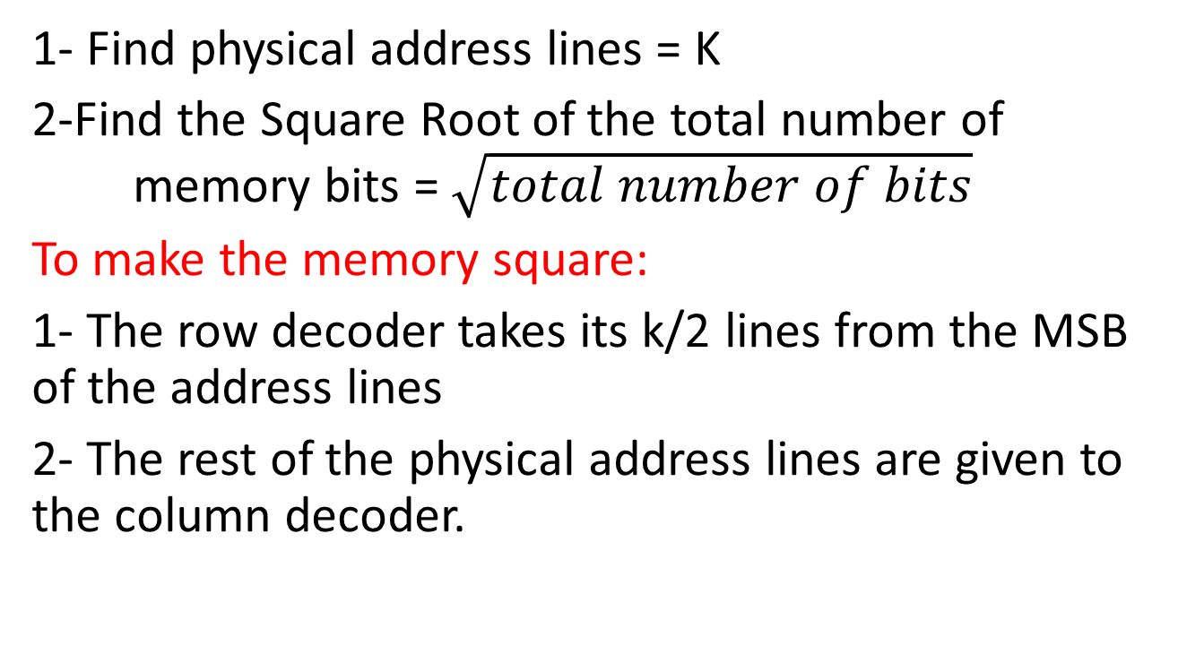
Procedure
1- Find physical address lines = K
2-Find the Square Root of the total number of memory bits = $\sqrt{total number of bits}$
To make the memory square:
1- The row decoder takes its k/2 lines from the MSB of the address lines
2- The rest of the physical address lines are given to the column decoder.

Slide 25
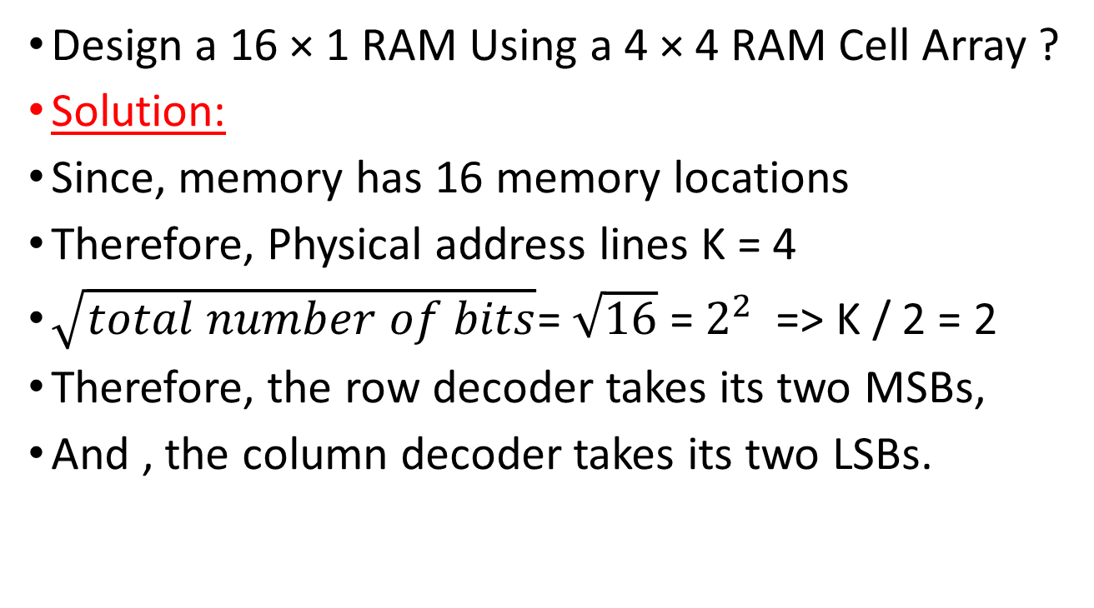
Example
Design a 16 × 1 RAM Using a 4 × 4 RAM Cell Array ?
Solution:
Since, memory has 16 memory locations
Therefore, Physical address lines K = 4
$\sqrt{total number of bits}$= $\sqrt{16}$ = $2^{2}$ => K / 2 = 2
Therefore, the row decoder takes its two MSBs,
And , the column decoder takes its two LSBs.

Slide 27
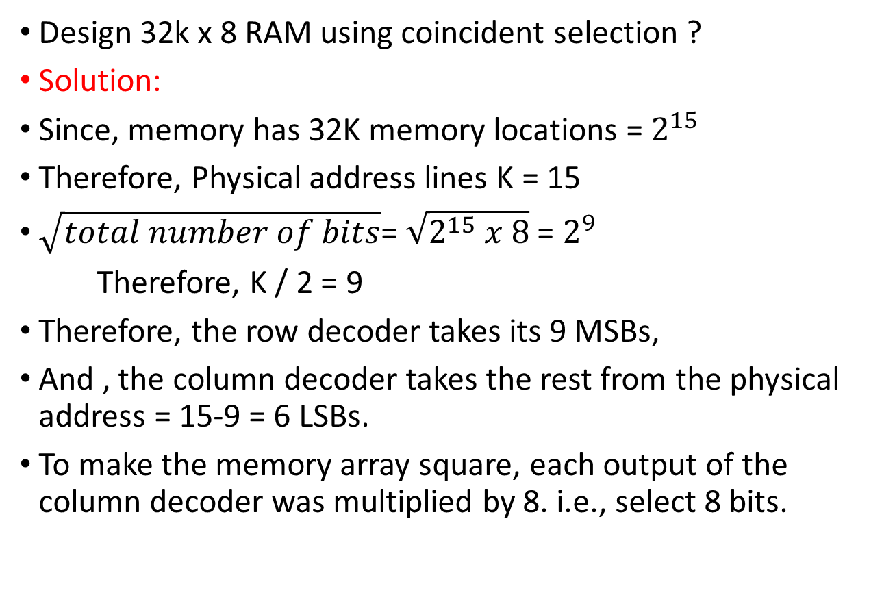
Example
Design 32k x 8 RAM using coincident selection ?
Solution:
Since, memory has 32K memory locations = $2^{15}$
Therefore, Physical address lines K = 15
$\sqrt{total number of bits}$= $\sqrt{2^{15} x 8}$ = $2^{9}$
Therefore, K / 2 = 9
Therefore, the row decoder takes its 9 MSBs,
And , the column decoder takes the rest from the physical address = 15-9 = 6 LSBs.
To make the memory array square, each output of the column decoder was multiplied by 8. i.e., select 8 bits.

Slide 28
Assignment
1. Explain the construction & operation of sense amplifier in SRAM?
2. The following memories are specified by the number of words times the number of bits per word. How many address lines and input–output data lines are needed in each case?
(a) 48K × 8, (b) 512K × 32, (c) 64M × 64, and
(d) 2G × 1.

Slide 29
Cont.,
3. *A 64K × 16 RAM chip uses coincident decoding by splitting the internal decoder into row select and column select. Assuming that the RAM cell array is square, what is the size of each decoder, and how many AND gates are required for decoding an address?

Slide 30
ARRAY OF SRAM ICs
If the memory unit needed for an application is larger than the capacity of one chip, it is necessary to combine a number of chips in an array to form the required size of memory.
The capacity of the memory depends on two parameters: the number of words and the number of bits per word.

Slide 31
Procedure
An increase in the number of words requires that we increase the address length.
Every bit added to the length of the address doubles the number of words in memory.
An increase in the number of bits per word requires that we increase the number of data input and output lines, but the address length remains the same.

Slide 32
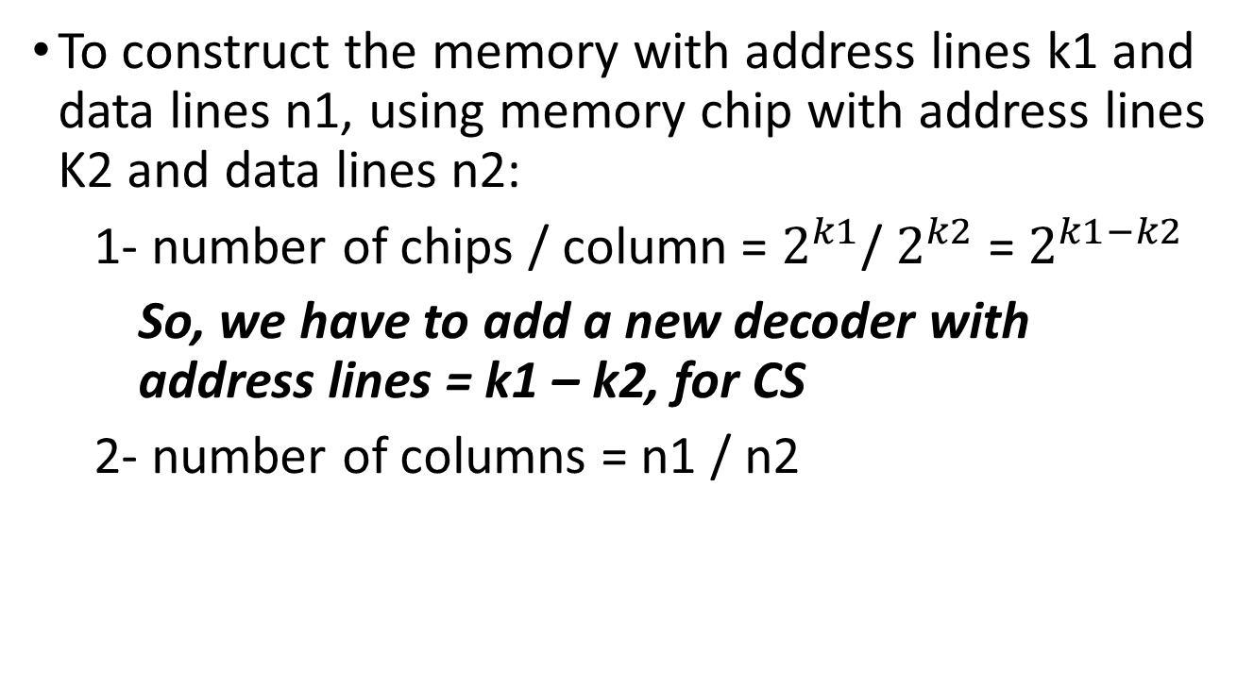
Cont.,
To construct the memory with address lines k1 and data lines n1, using memory chip with address lines K2 and data lines n2:
1- number of chips / column = $2^{k1}$/ $2^{k2}$ = $2^{k1−k2}$
So, we have to add a new decoder with address lines = k1 – k2, for CS
2- number of columns = n1 / n2

Slide 33
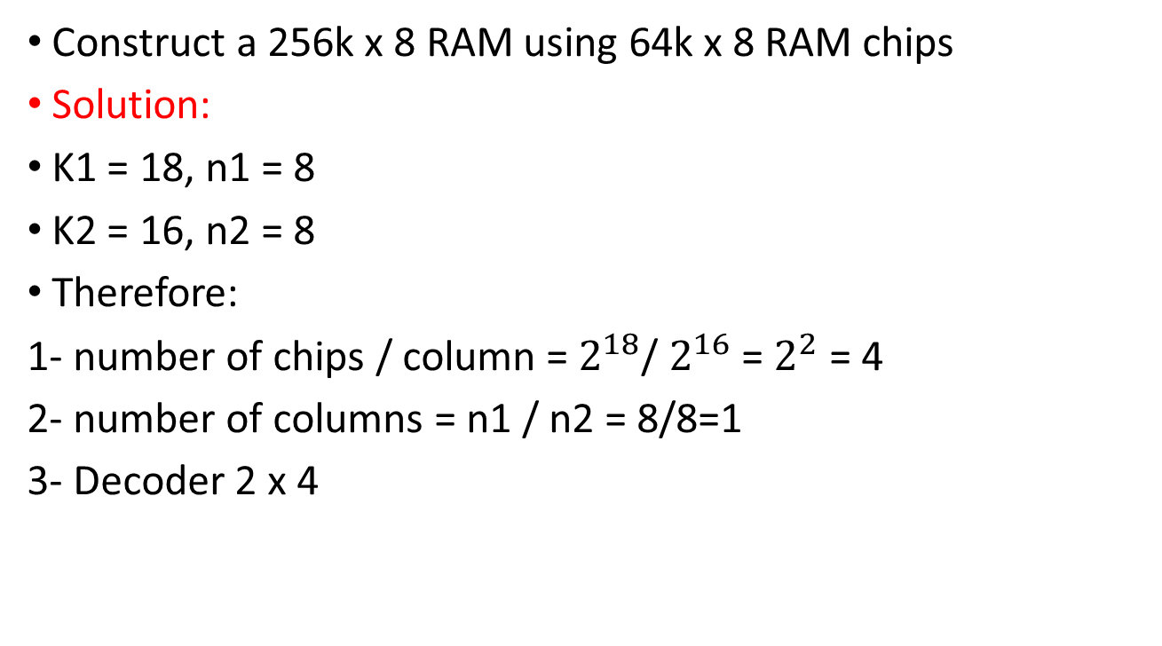
Example
Construct a 256k x 8 RAM using 64k x 8 RAM chips
Solution:
K1 = 18, n1 = 8
K2 = 16, n2 = 8
Therefore:
1- number of chips / column = $2^{18}$/ $2^{16}$ = $2^{2}$ = 4
2- number of columns = n1 / n2 = 8/8=1
3- Decoder 2 x 4

Slide 36
Example
Construct a 64K x 16 RAM using 64k x 8 RAM.

Slide 37
Sheet
1- Using the 64K × 8 RAM chip plus a decoder, construct the block diagram for a 512K × 16 RAM.
2- *(a) How many 128K × 16 RAM chips are needed to provide a memory capacity of 2 MB = 1 M x 16 RAM?
(b) How many address lines are required to access 2 MB? How many of these lines are connected to the address inputs of all chips?

